Slide 1










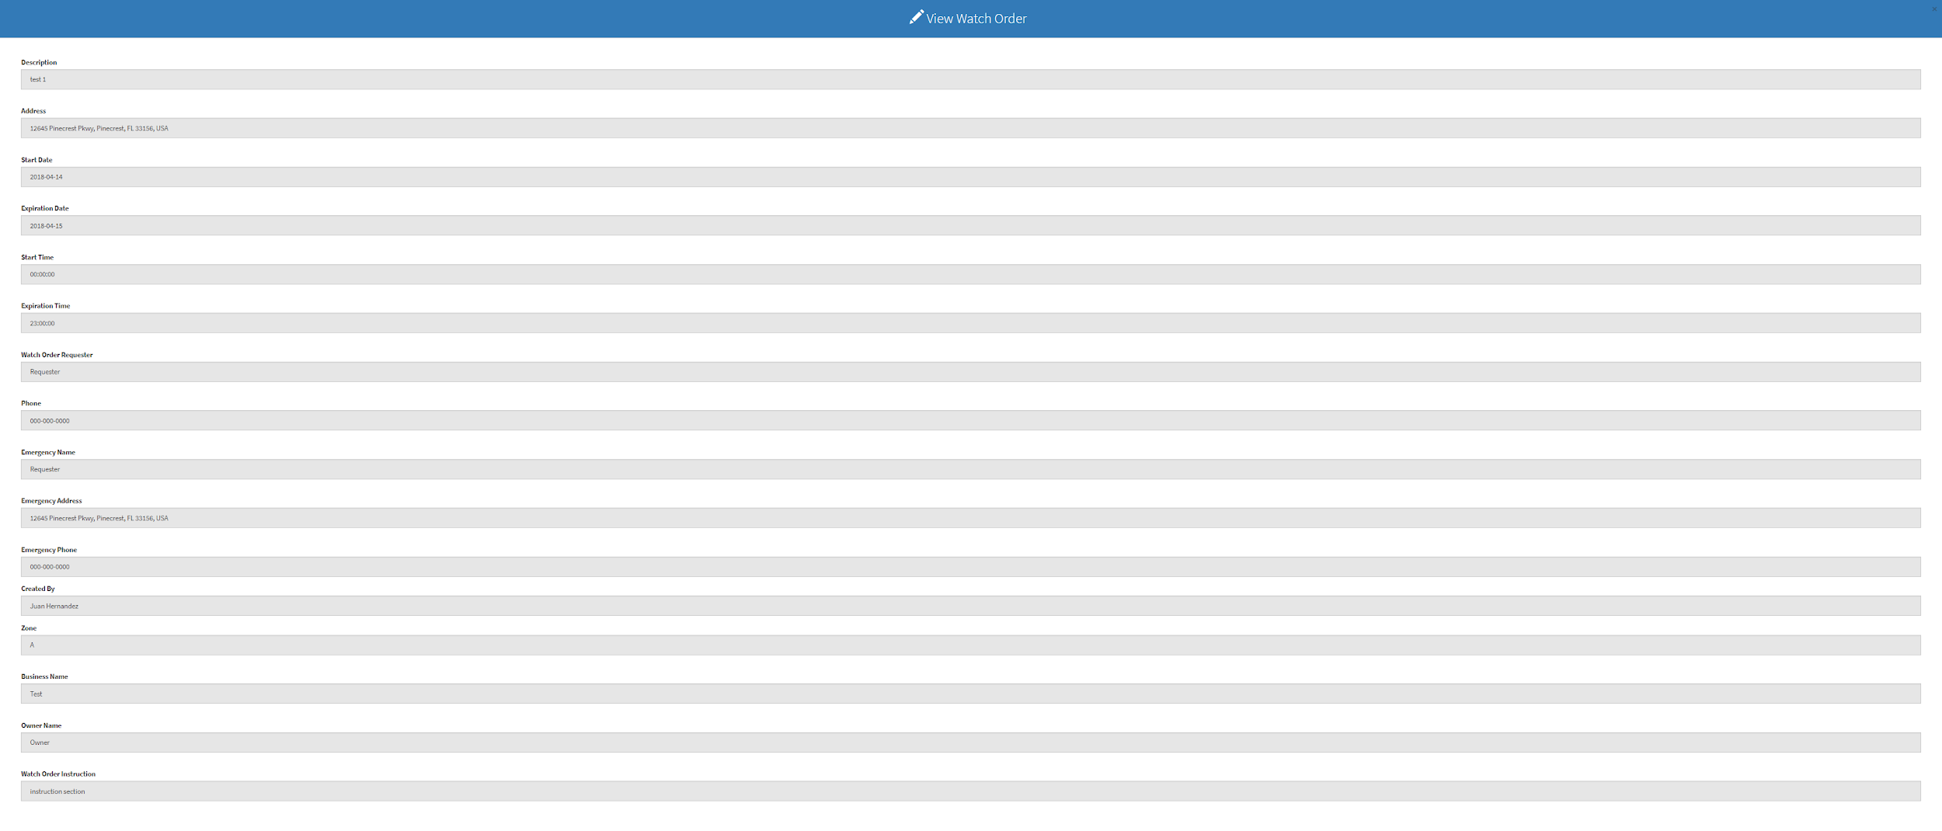
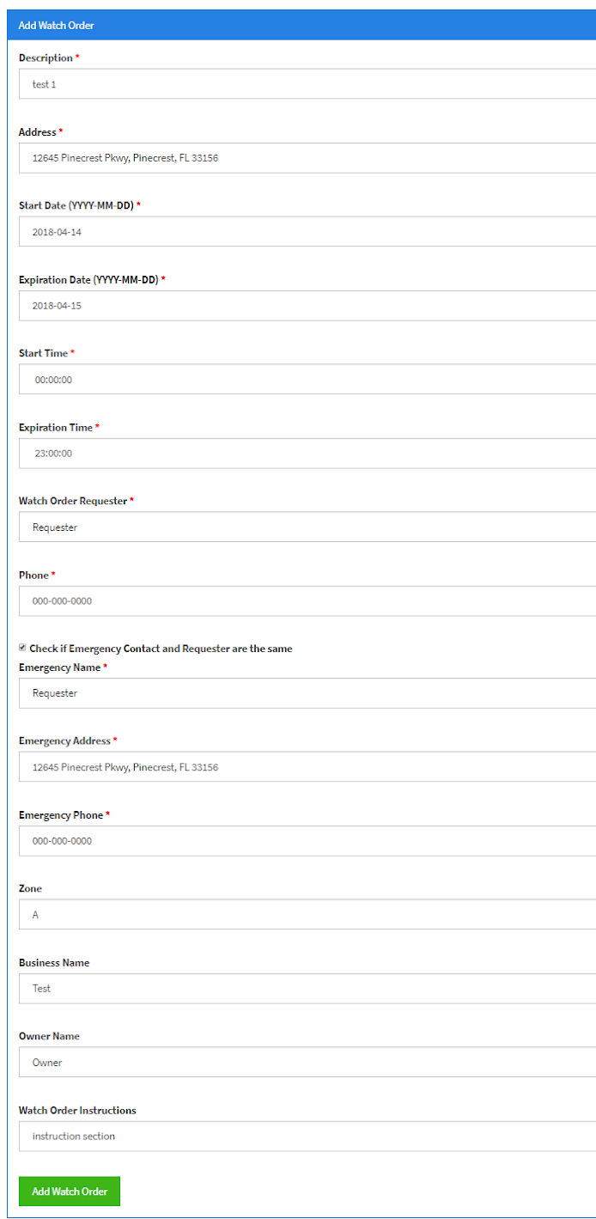
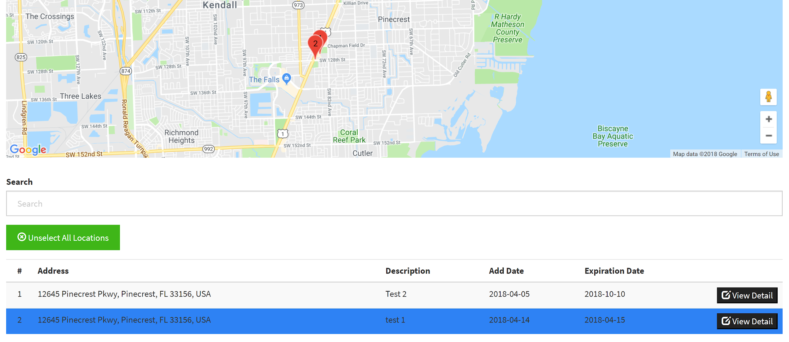
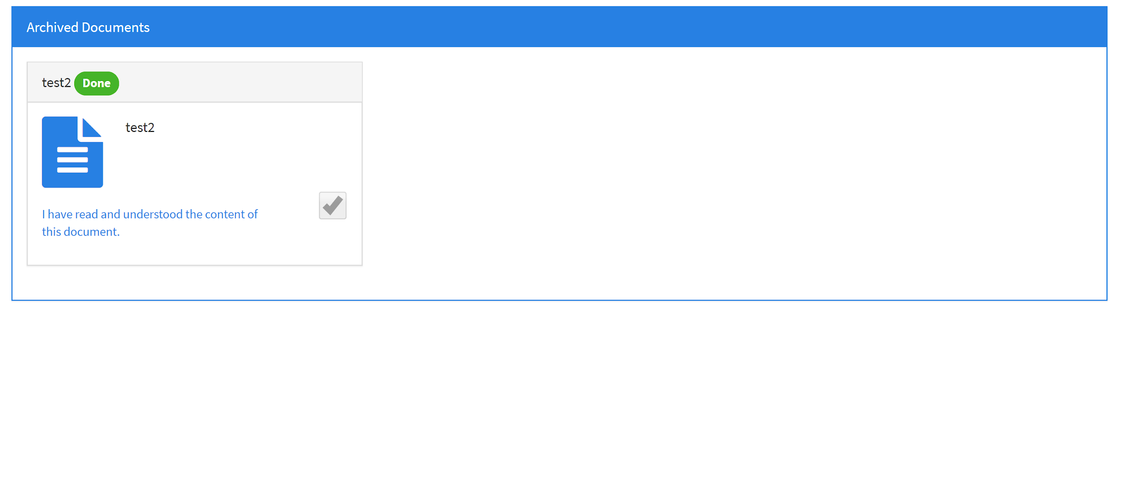
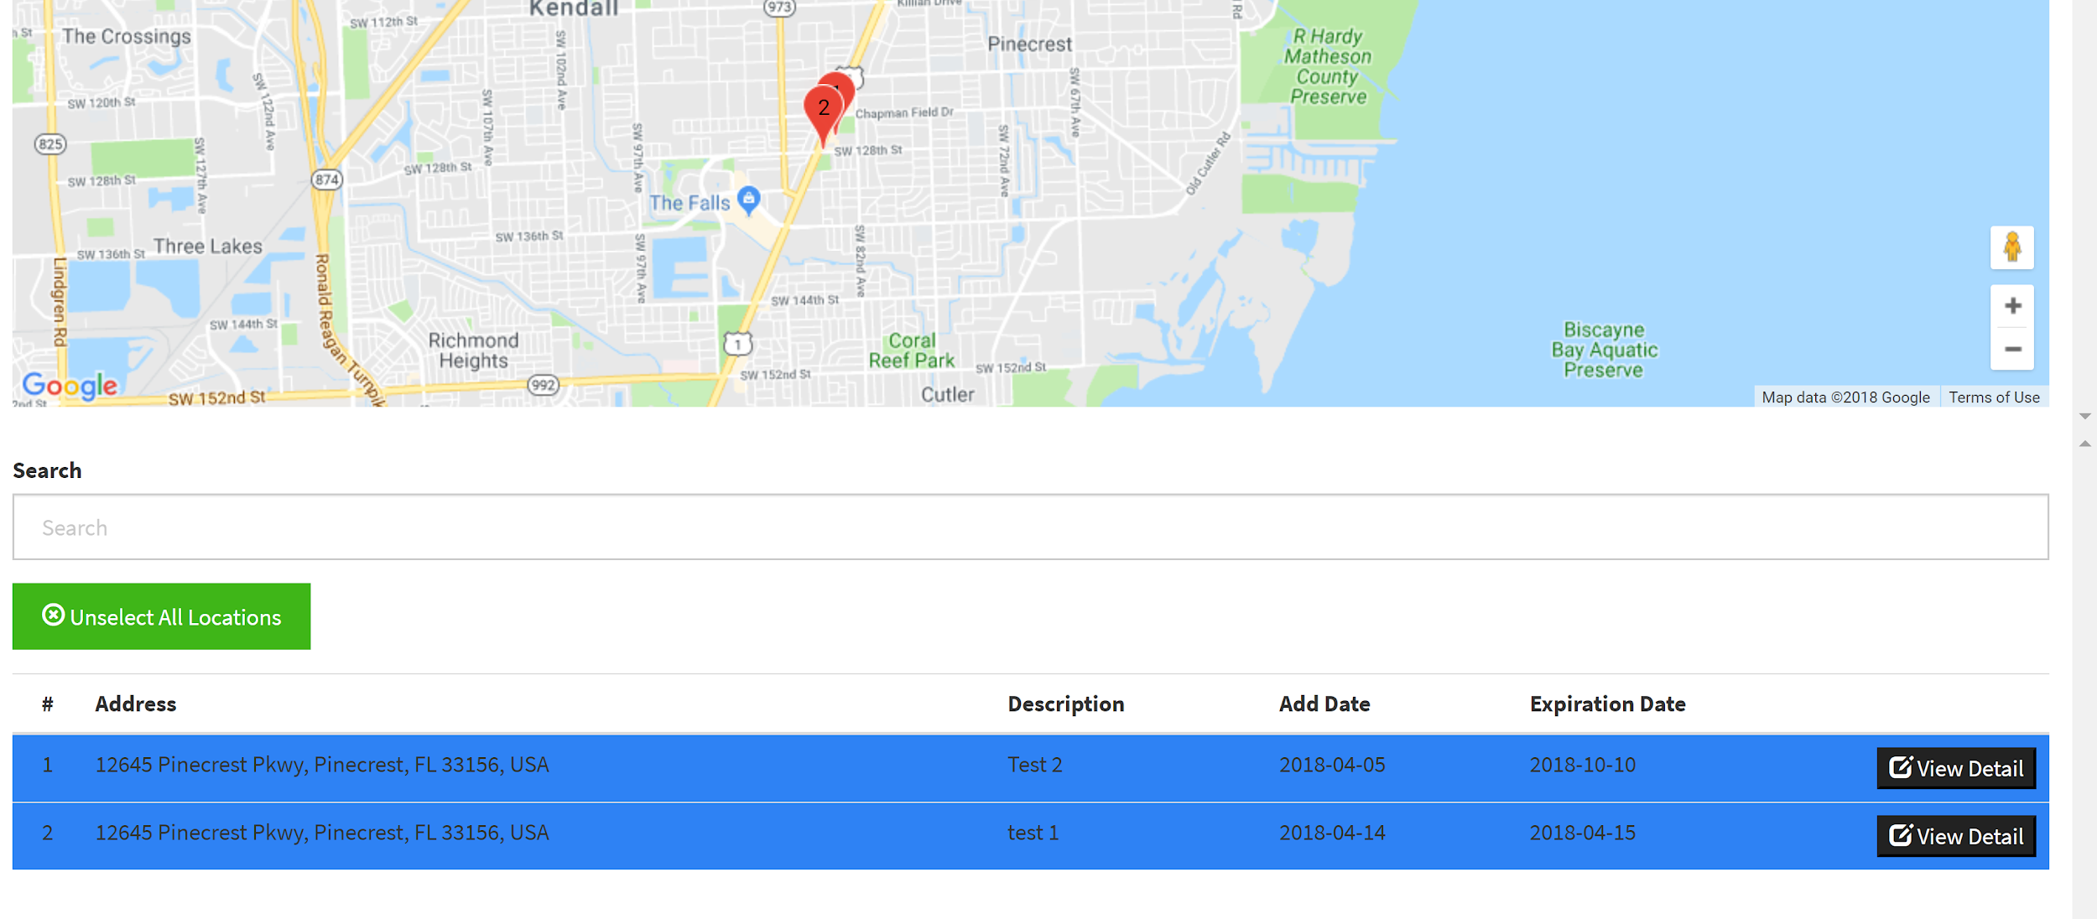
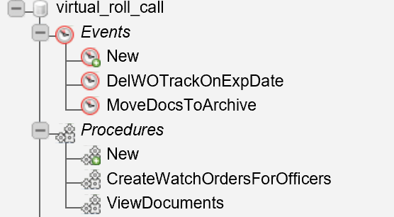
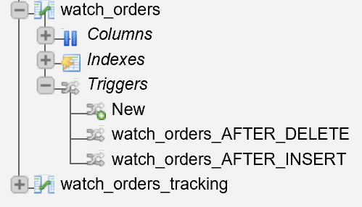
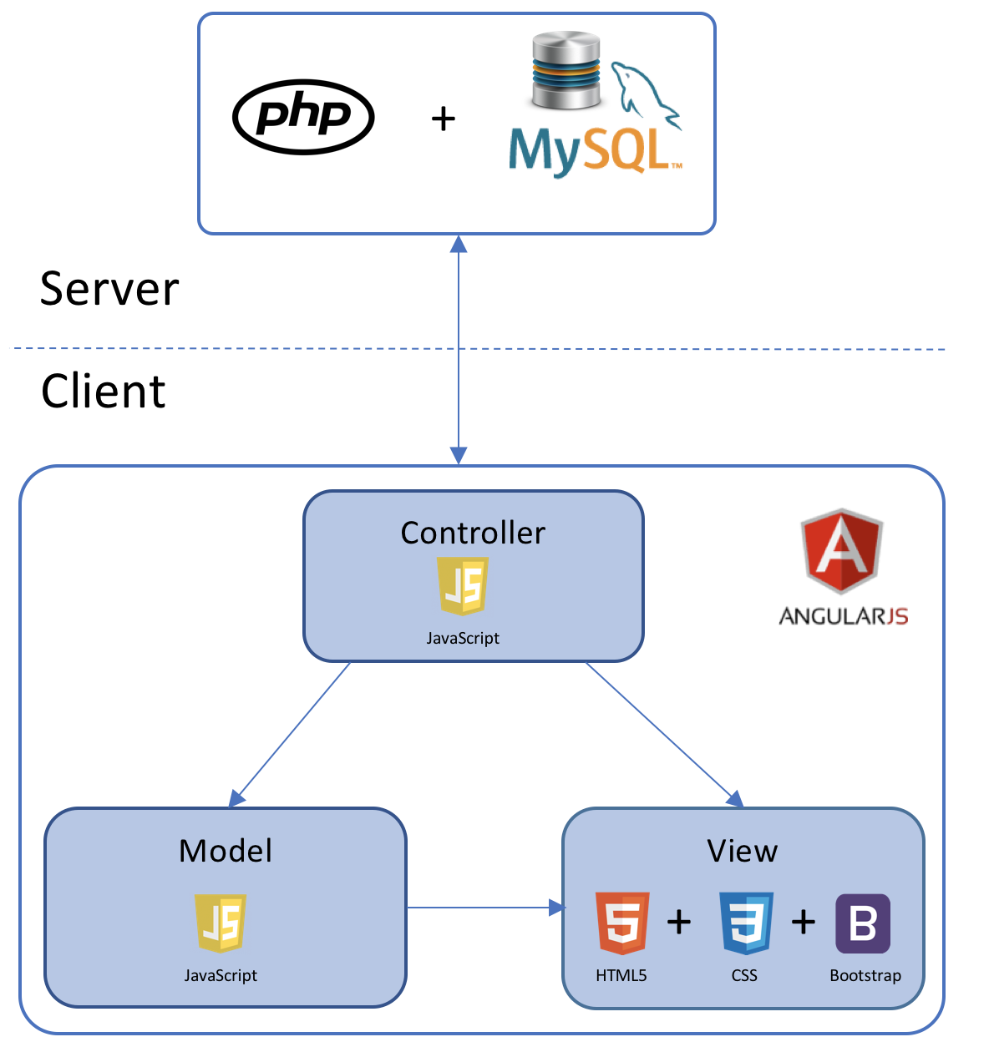
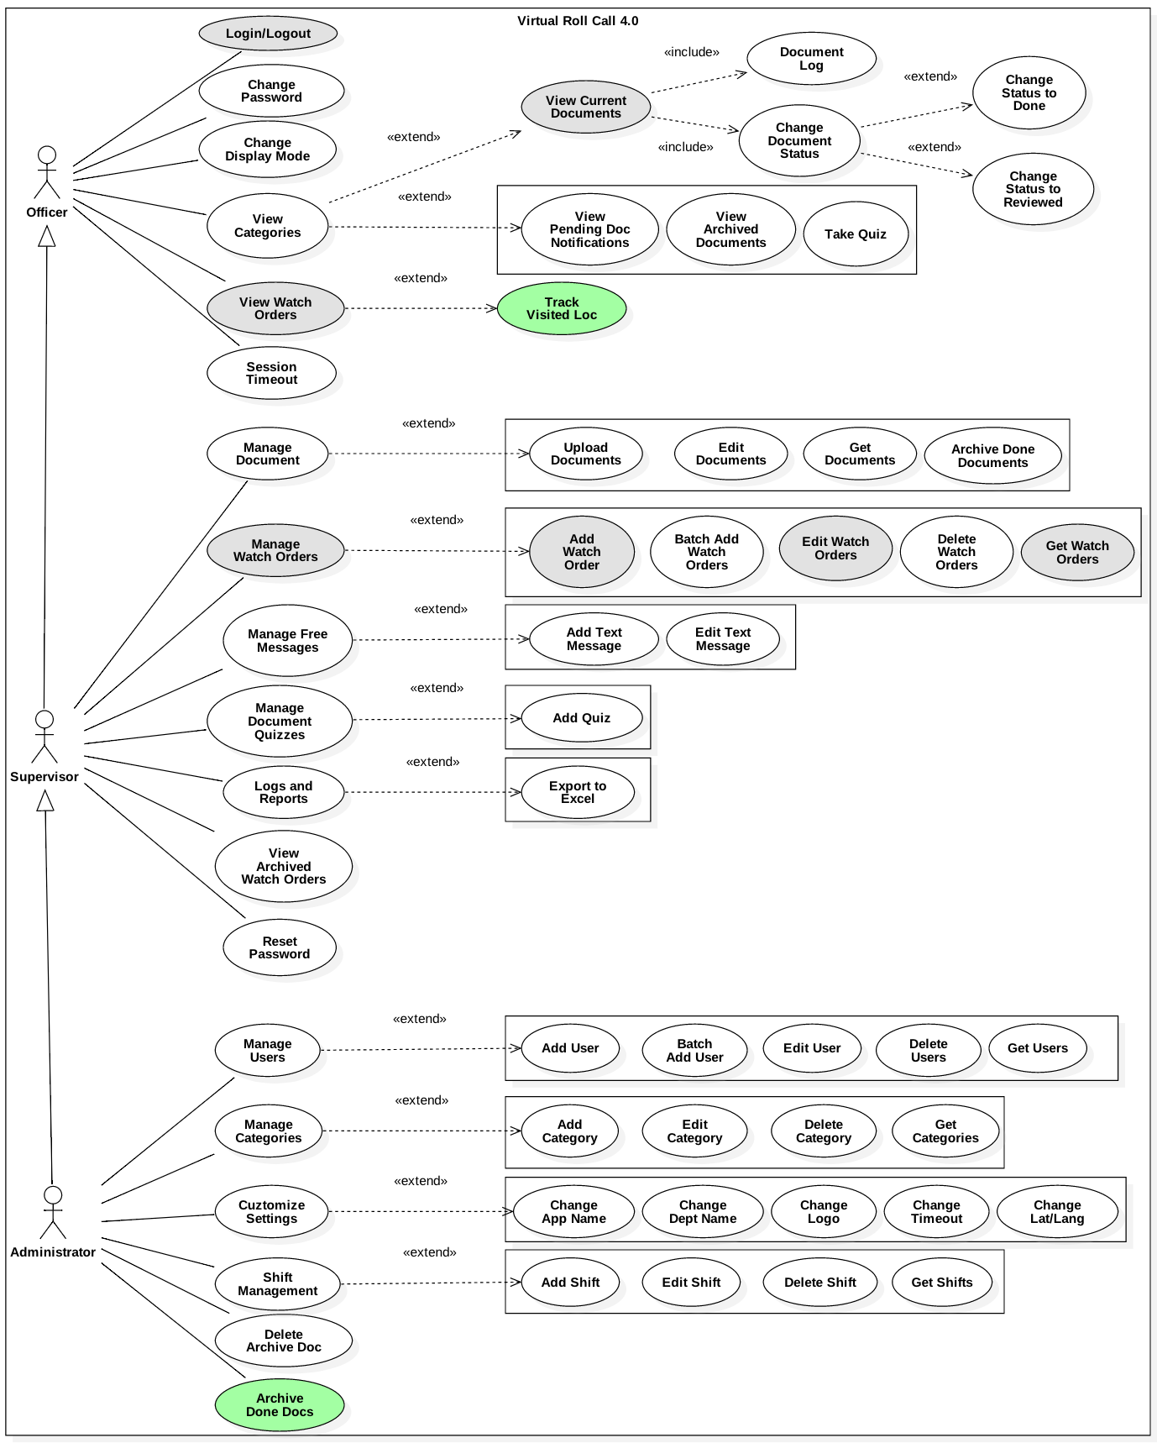

School of Computing & Information Sciences
Senior Project, 2018, Spring
Virtual Roll Call 4.0
Student: Juan Hernandez, Florida International University
Mentor: Juan Caraballo, Florida International University
Jason Cohen and Frank Alvarado, Pinecrest Police Department
Professor: Masoud Sadjadi, Florida International University
Problem
Roll Call is a briefing meeting in police departments.
Shift supervisors give assignments and share critical information with the officers
Officers cannot always be present for this meetings.
After the meeting is over it is very difficult to distribute the information to the officers.
Solution
The Virtual Roll Call web application will solve and provide:
Assignments and critical information are always online and in real-time.
Officers no longer required to assist to roll calls.
Ability for officers to track visited locations.
Ability to archived documents automatically.
Enhance Watch Order Feature.
Current System
Version 3.0 is currently in use by the Pinecrest Police Department. My contributions to version 4.0 are:
Mark and unmark visited locations.
Watch Order has more input data fields.
Watch Order display all information along with the name of the person who create it.
Documents are mark as archive automatically and moved to archive folder
Enhance login and document viewer.
Requirements
Archive documents which has been marked as “Done” and the creation date has passed 7 days.
Watch Order Form must match the original physical paper currently used.
Display all the information enter along with the person who entered.
Ability for officers to mark and unmark visited location. Have button to unselect all. Officer’s marked locations need to
be saved in database.
Enhance login and view document features
System Design
Object Design
Verification
Test Case ID: Story #331 Keep track of visited location
Purpose: Verify that officers can select and unselect locations that have been visited. also have the ability to unmark them all at once. Verify that officers can unselect all by clicking “Unselect All Locations”. Verify that the visited location still show as selected after the officer exit the screen and enters again.
Precondition: Officer is logged in. Officer is at the “View Watch Order” screen. Officer can see the watch orders created.
Input: Officer click the row containing the visited location. Officer exits “View Watch Order” screen. Officer goes back to “View Watch Order” screen. Officer click the highlighted row to unselect. Officer select all location and click “Unselect All Location” button.
Expected Output: Officer can see that location is selected after clicking the row. Officer can see the highlighted location after he/she exit screen and goes back in. Officer can see that all location unselect after he/she select all the location and click the “Unselect All Location” button.
Actual Output: Officer was able to see that a location get selected after clicking the row. Officer was able to see the highlighted location after he/she exit screen and goes back in. Officer was able to see that all location unselect after he/she select all the location and click the “Unselect All Location” button.
Status: Pass
Implementation
Front-End: HTML 5, CSS, Bootstrap, JavaScript, AngularJS
Back-End: PHP
Database: MySQL
Web-Server: Apache HTTP
Summary
The Virtual Roll Call 4.0 gain new features and improvements such as:
Ability to track visited locations.
Ability to archive “Done” documents.
Improve Watch Order Form.
Ability for Officers to see the person responsible for creating Watch Orders
Improve the login and view documents.
Use Case Diagram
FOLLOW US @FIUSCIS
Acknowledgement
The material presented in this poster is based upon the work supported by the Pinecrest Police Department. I am thankful for the help that I received from my group members: Darilys Pereira, Product Owner Jason Cohen, and Frank Alvarado.
Notes:
‹#›

